Slide 1
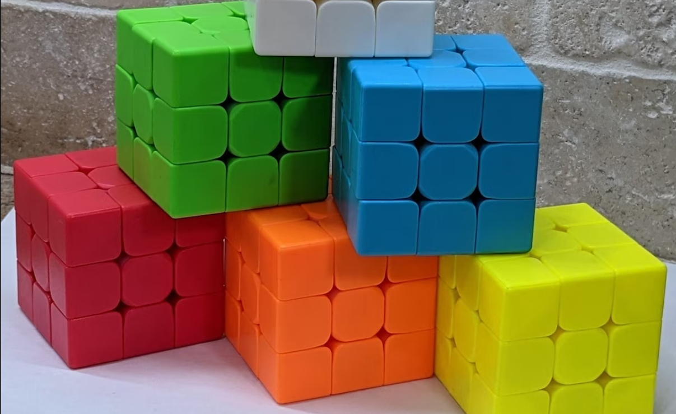
Rubik’s cube solver
Computer vision and artificial intelligence project
Simone Sestito <sestito.1937794@studenti.uniroma1.it>
Alessandro Scifoni <scifoni.1948810@studenti.uniroma1.it>
Sabrina Troili <troili.1932450@studenti.uniroma1.it>

Slide 2

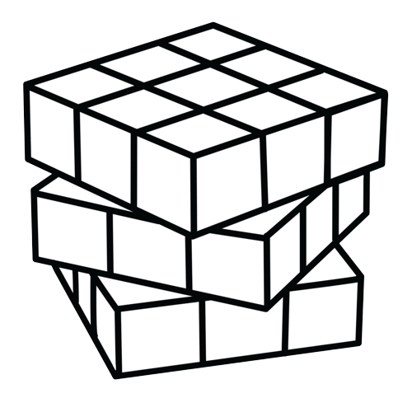
Project areas
AI Move prediction
Real-world cubes recognition
Notes:
the project is divided into 2 parts: computer vision (describes how we obtain the representation
of the real cube through opencv
) and Artificial intelligence model ( the model used to predict the moves to solve the cube)

Slide 3
Cube Simulator
Notes:
But first

Slide 4
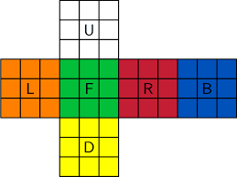
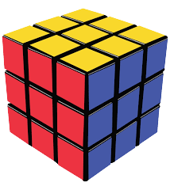
Flattened representation
Standard representation
Notes:
cubes have 6 faces, each has 9 cells, so multidimensional array having shape (six times three times three). Every cell has a colour represented by a number. We established an order of the faces to work easily but the user can take the pictures in any order.

Slide 5
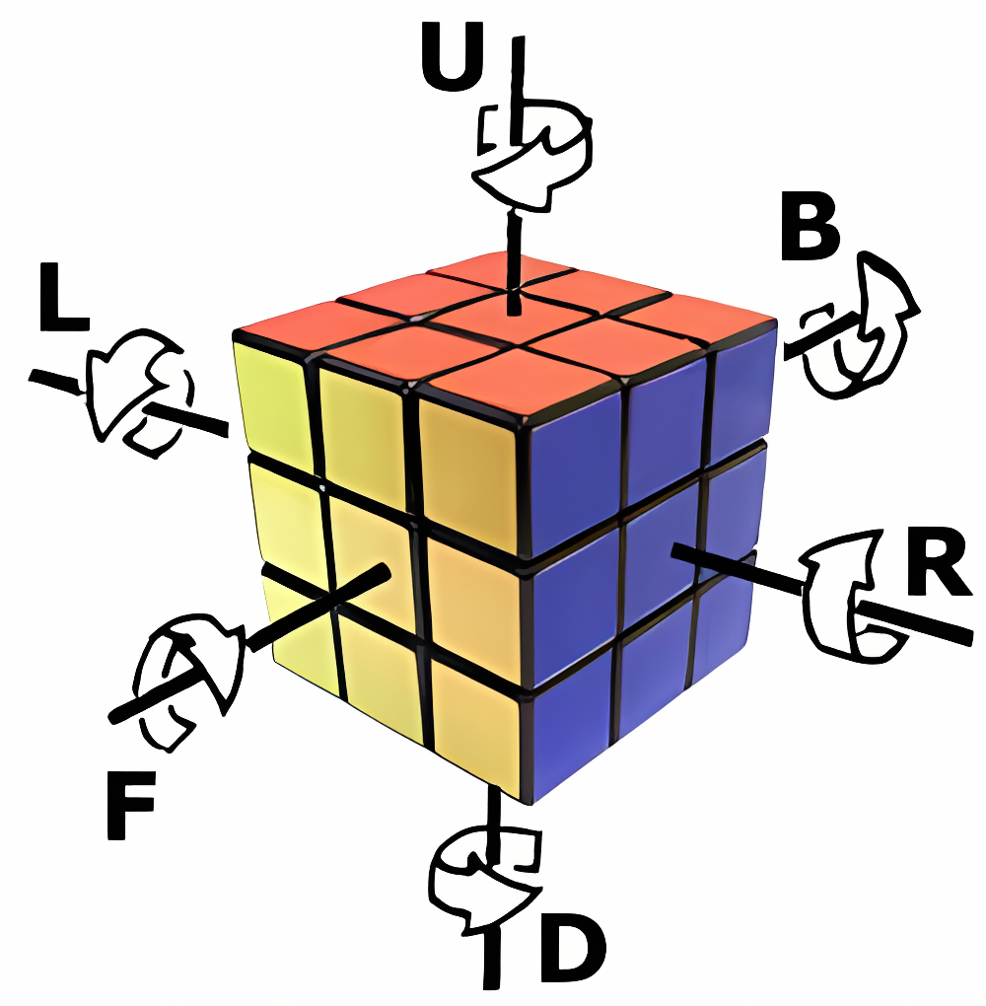
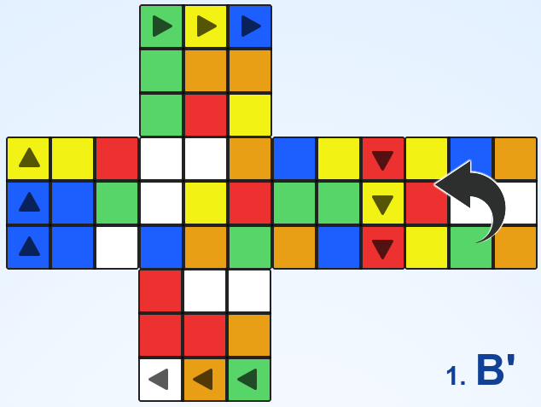
Standard notation
Rotate matrix and flip row or column?
Notes:
a move is a rotation of a matrix and adjust adjacent faces’ columns and rows. An example of counterclockwise rotation of back face. The total number of moves is 12

Slide 6
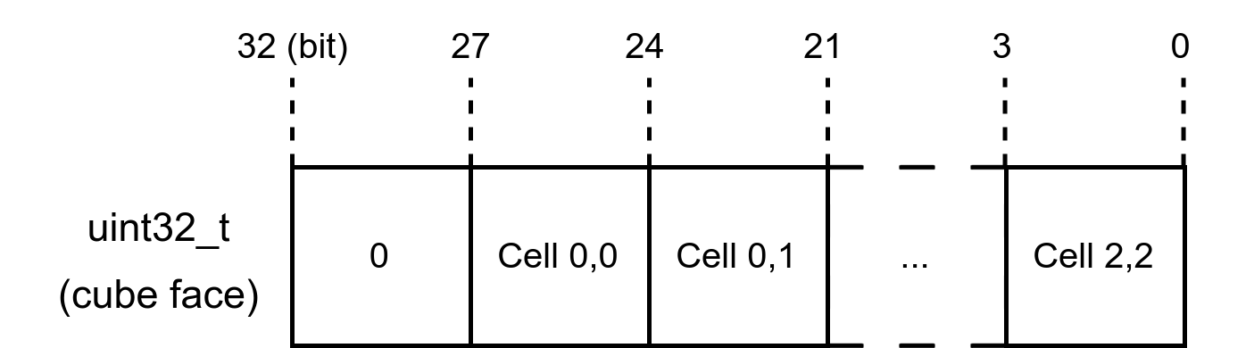
C optimization
Each cell can assume 6 values rappresentable with 3 bits,
so to represent a face we need 9x3=27 bits, rounded to 32 bits.
So a cube can be represented with 24 bytes!
Notes:
performances! a representation of cube with 24 bytes instead of 54, 55% of memory saved and we access to the cube with left and right shifting operation.

Slide 7
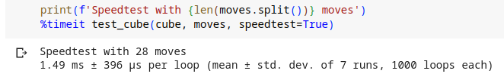
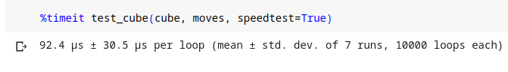
C implementation
Notes:
thanks to the timeit function we can see a performance increase because the c code takes a tenth of the time used by the python code

Slide 8
OpenCV Recognizer

Slide 9
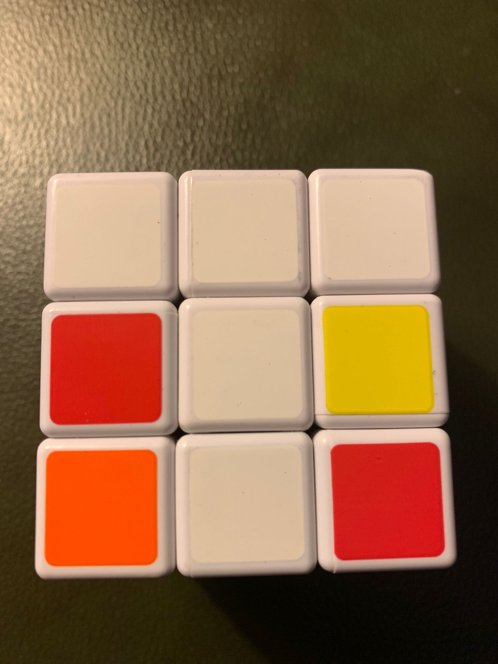
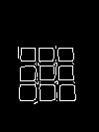
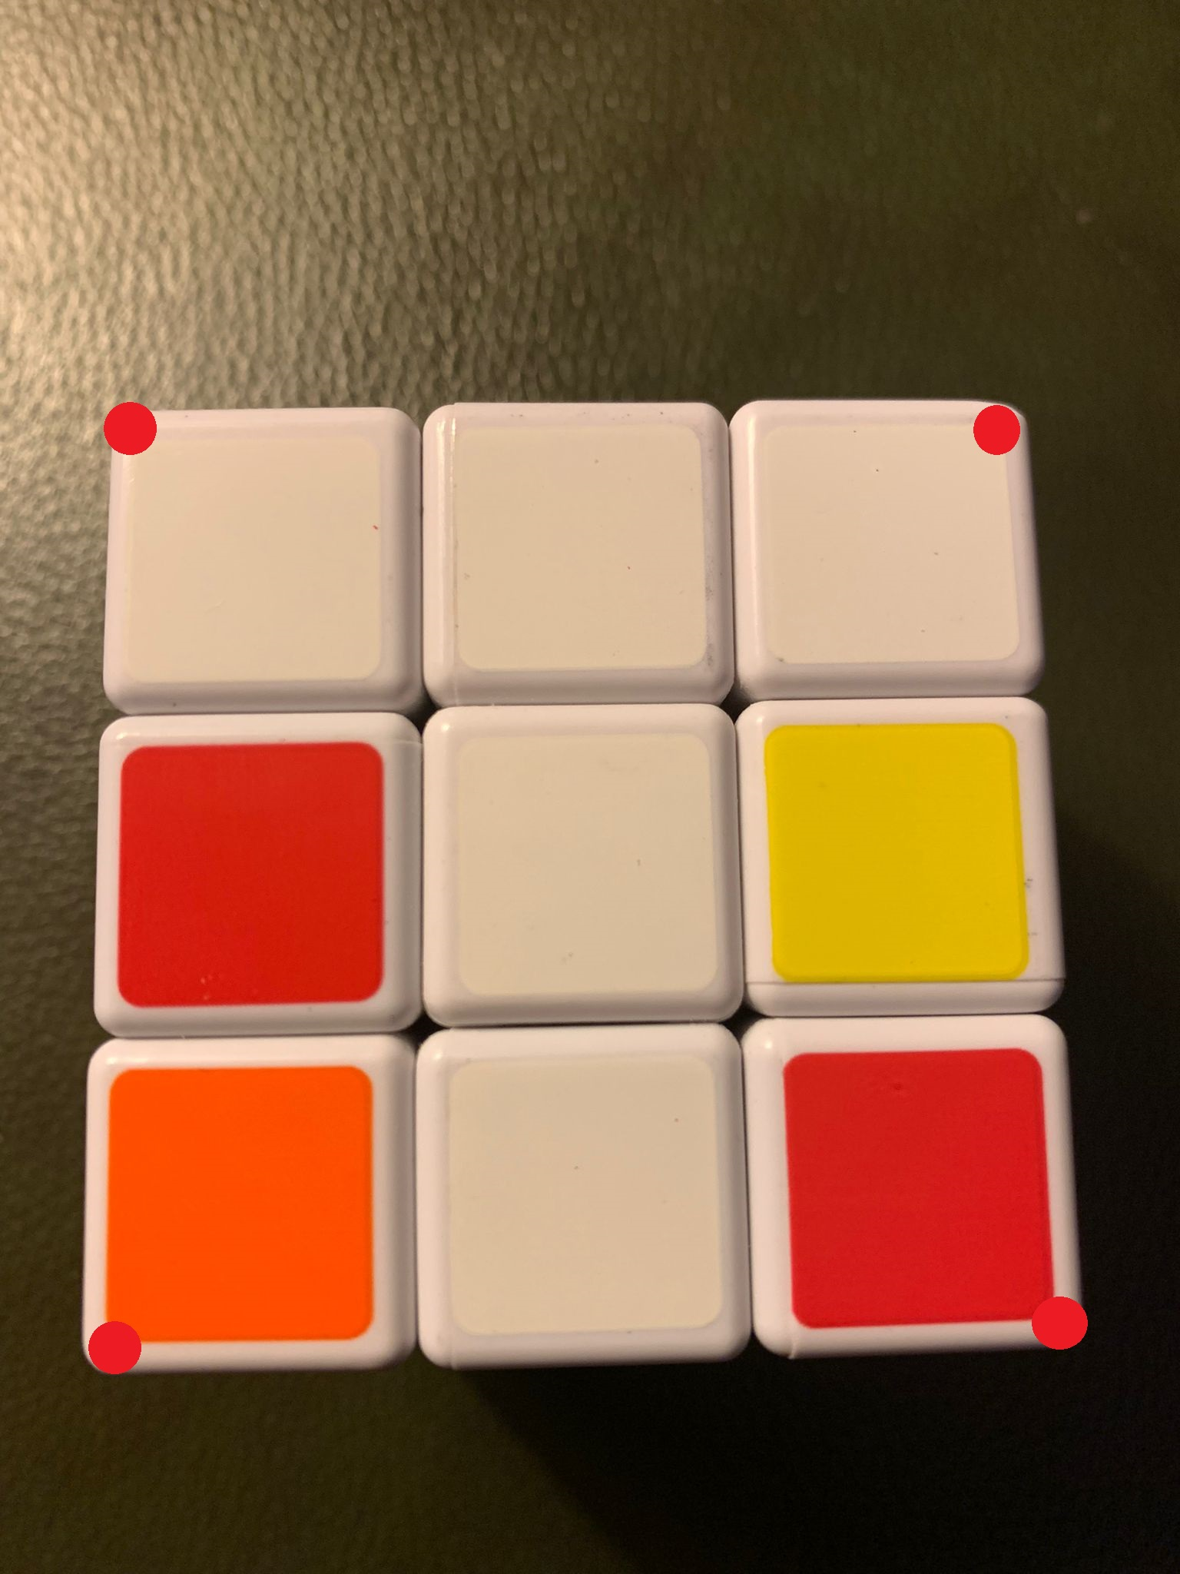
How to get the matrix?
What are the steps?
1. Take pictures of the cube faces
2. Identification of the edges
3. Get the vertices
Notes:
Edge detection with the function canny, we obtain the coordinates of the vertices with mathematical function, for example the top left vertex is the maximum sum between x and y coordinates

Slide 10
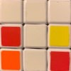
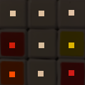
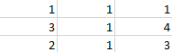
4. Eliminate the outer outline
5. Get a pixel from the cells
6. Build the matrix
Notes:
then we apply a gaussian blur to smooth the cells to be sure there is a low difference between pixels of the same cell. Eliminate the background with an omography to map starting points to end points. The next is to get a pixel from the cells a build the matrix, but before we apply a blur operation. At the end we build the matrix using inRange function to recognise the pixel and associate the correct number

Slide 11
Dataset
Notes:
Let’s talk about the dataset.
Or should I say “the datasetS”, because we have not 1 but 2 OF THEM.
But let’s start understanding how are they actually created

Slide 12

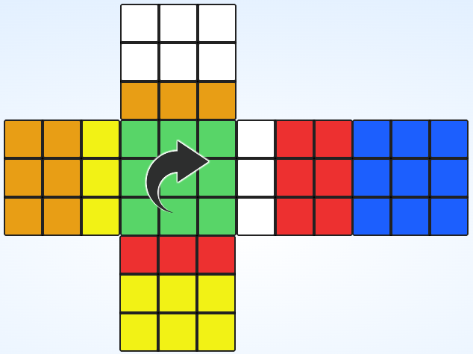
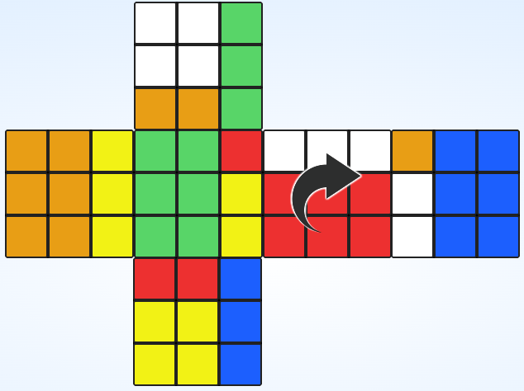
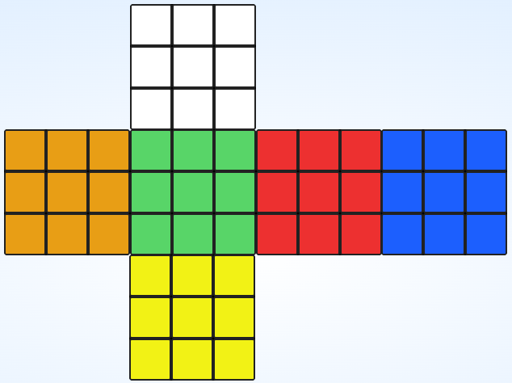
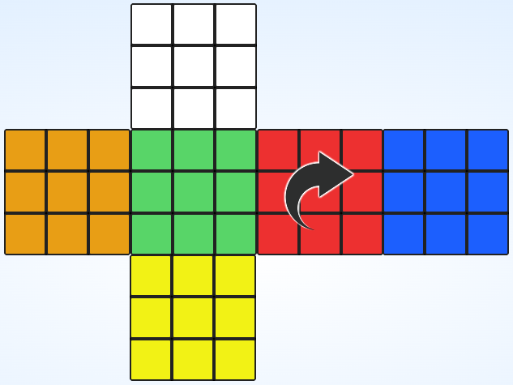
Dataset: how to find cubes
Depth-First?
Notes:
We may think of using a Depth-First approach, like: I start from a cube, then I apply a move, recursively appling all of the 8 moves I need. WRONG!
Too easy!

Slide 13
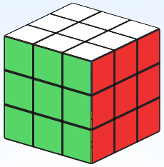
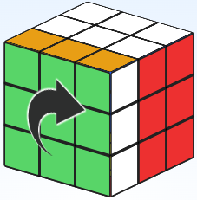
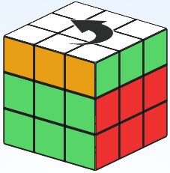
Dataset: don’t use DFS
But why?
Depth 0
Depth 1
Using DFS, it’s already known at this point
but with a suboptimal path!
Depth N
Notes:
Let’s begin with our solved cube, and go with a depth first approach.
We get our cube at depth 1, then we go deeper and deeper until at Depth N we get this other cube. Looks WAY TOO simple to be at depth N (like depth 5,6 or even 8)
But for our program, that’s still fine.
Now we finished doing all the steps at depth N, and we are back at depth 0, ready for the next move.
And we get… THE SAME but this time it has depth 1, much shorter path.
Since we are keeping track of the moves we make in order to be able to solve the cube later on, it’s an enormous waste of time
to analyze cubes that are potentially suboptimal.

Slide 14
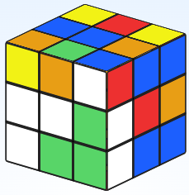
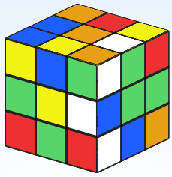
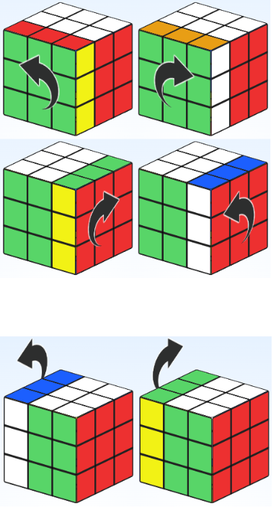
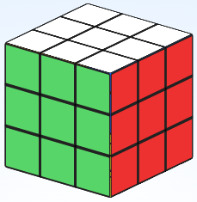
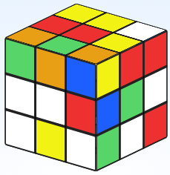
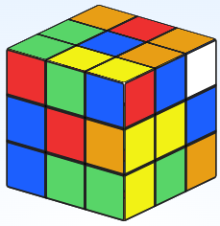
Dataset: how to find cubes, the right way
Breadth-First!
…
…
…
…
…
…
Step 1
Step 2
Step 8
Notes:
We need to use a breadth first approach.
In fact, we first apply ALL the moves to the initial cube
Then, we get all the cubes at step 2, and apply ALL the moves again.
We go so on and so forth: at every step we get ALL the cubes at step i-1, apply all the moves, discarding the already known ones, and that is step i.
After all the steps are made, we JOIN them all and that’s the resulting step

Slide 15
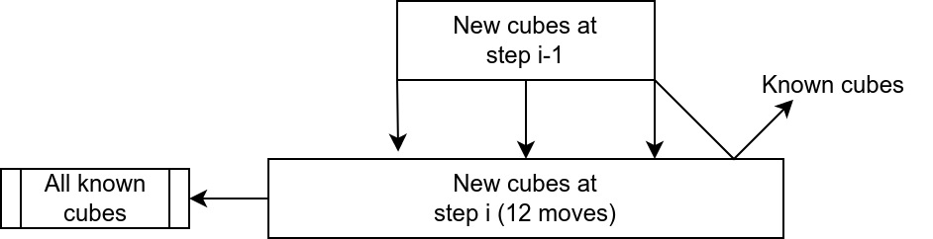
Dataset: how to find cubes, the right way
Breadth-First!
In a nutshell
Notes:
We need to use a breadth first approach.
In fact, we first apply ALL the moves to the initial cube
Then, we get all the cubes at step 2, and apply ALL the moves again.
We go so on and so forth: at every step we get ALL the cubes at step i-1, apply all the moves, discarding the already known ones, and that is step i.
After all the steps are made, we JOIN them all and that’s the resulting step

Slide 16
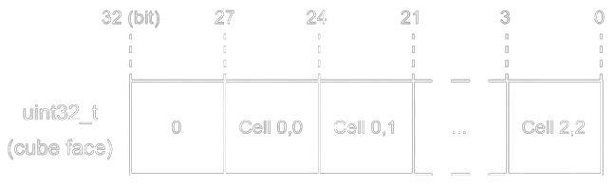
3x3 Cubes Dataset
We use the same optimized encoding of cubes in memory
Used as a solver map for cubes recognized with OpenCV
≈ 86 million cubes
> 2GB on disk
for each cube face
+ 1 char for the move
Notes:
But I said that we have not one but TWO datasets.
The first one is the 3by3 cubes dataset and, while in the original project that should be used for everything,
a little variations took us to the point were we had to re-calibrate the order of difficulty of our project.
But, we kept this dataset as a (CLICK) solver map able to optimally solve all the cubes reachable in less than 9 moves from the solved cube
which is the starting point.
We already know the problem is exponential, but how much could it be? Well… (CLICK)
86 million cubes!
Which are a total of MORE than 2GB of file on disk, a lot!
And that’s not even a lot of space.
In fact, we used an OPTIMIZED ENCODING where using bitwise operations and using basically a single 32bit integer to save an entire face, where each cell is 3 bits.

Slide 17
2x2 Cubes Dataset
No need to use an optimized encoding
Every cube is 24 Bytes + 1 char (move)
Used to train our AI model
Always with 8 moves
It’s just a ~250MB file!
Notes:
And here it is the second dataset!
This one is simpler because uses 2by2 cubes,
(that’s what our AI model is trained on)
and it’s MUCH smaller, as you can see.
And this time we didn’t even use the FANCY ENCODING seen earlier, because it’s unnecessary on this small space

Slide 18
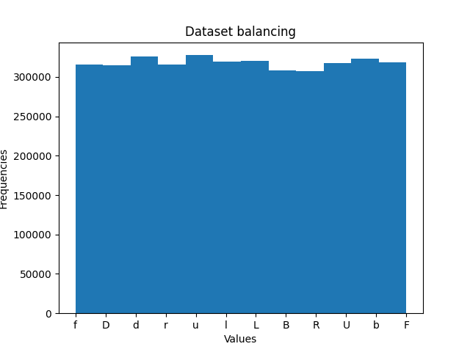
And it’s balanced!
Samples per class, where the class is the optimal move to perform
Notes:
Finally, the dataset is also balanced!
Here you can see how many samples are there for each move (which is the label)

Slide 19
AI Model and Evaluation

Slide 20
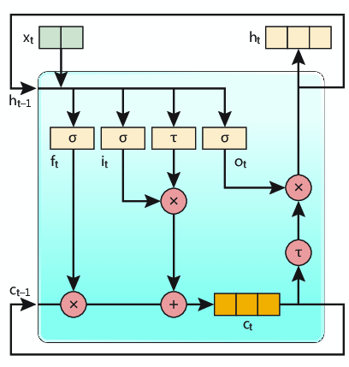
LSTM Model
A model with memory.
Notes:
We used the LSTM model and we want to point out that we couldn’t find any other project using the same model.
So we can somehow say we are the first (?!)
LSTM (Long Short-Term Memory) is a type of recurrent neural network used to analyze and understand sequential data. It is designed to overcome issues faced by traditional recurrent neural networks, such as difficulty in handling long-term dependencies. This model uses special units called "memory cells" to store, access, and forget informations over time. The main tasks are 3: 1) An "input gate" decides which information from the current input should be stored in the memory cell. 2) A "forget gate" determines which information from the previous memory cell should be forgotten. 3) An "output gate" selects relevant information from the updated memory cell to produce a final prediction. In addition, LSTM can handle sequences of varying lengths and capture relevant information at different time steps. We decided to use this model because, in reference to what I just said, it is a temporal network that takes a sequence as input, so it allowed us to work with sequences.

Slide 21
Dataset change: before
+
R
Notes:
Dataset change
When we decided to use LTSM model the implementation of our project has already begun,
so before our input was a cube and the label of the optimal move to be performed, in this case, for example R.
Then, thanks to the usage of LSTM model we changed the input to the dataset…

Slide 22
…AFTER
+
R
Notes:
Now X must be an ordered list of 4 cubes and y the optimal move that solves the last of this list. Not even by putting 4 cubes we exceed 250MB of file

Slide 23
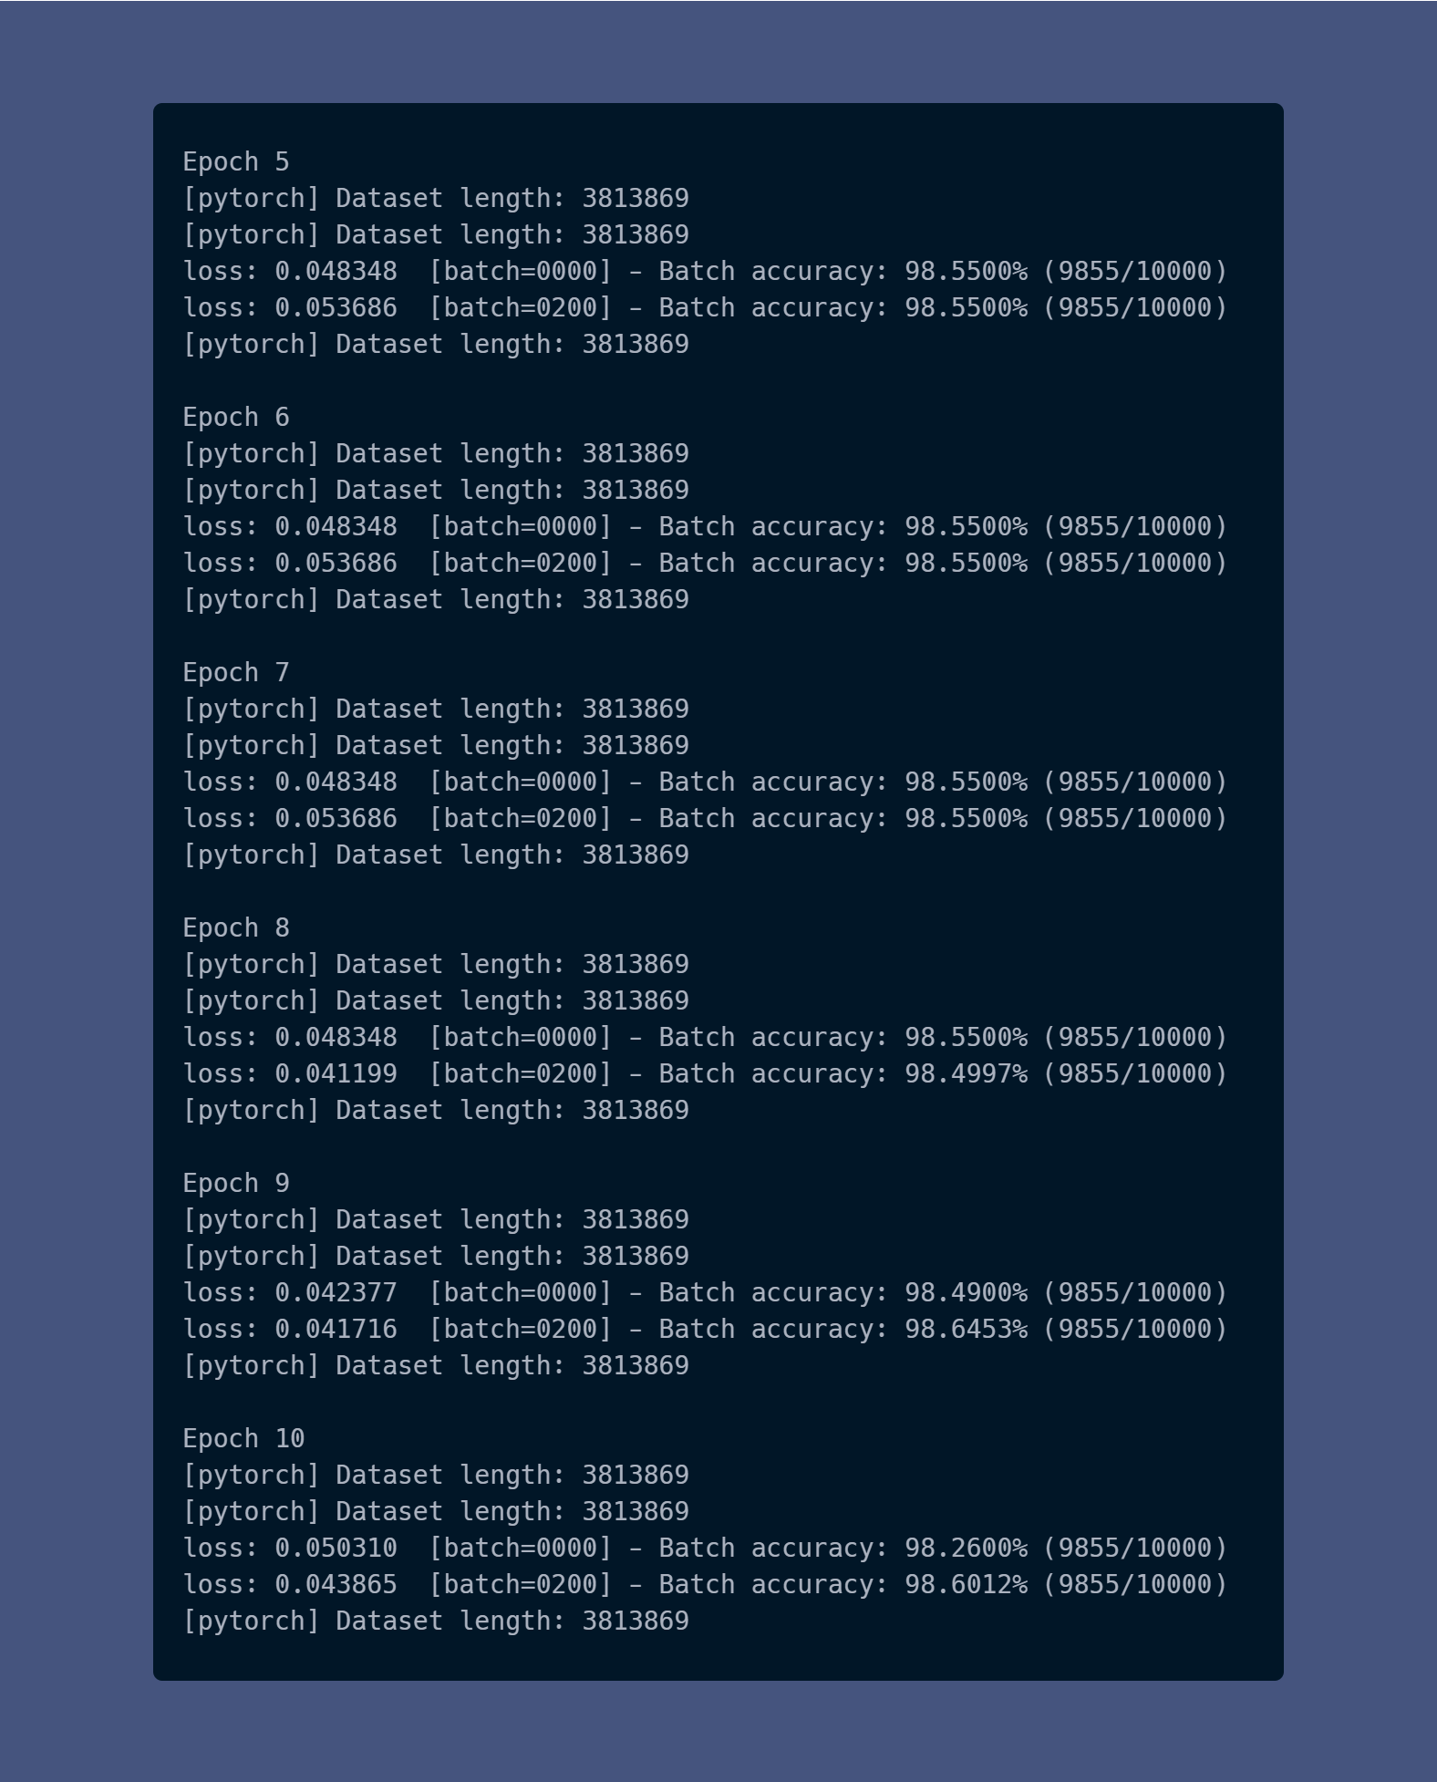
FIRST EXPERIMENT:
Series of tests using 10 epochs. Observation that starting with the 5th epoch, the results obtained are the same.
Notes:
During the development process, we performed a series of experiments to determine the impact of different variables on the performance of our model.
First of all, we decided to vary the number of epochs used during model training. We performed a series of tests using 10 epochs. We observed that starting with the 5th epoch, the results obtained were consistently the same. This suggests that the model has achieved stability and further iterations did not lead to significant improvements.
As we can see from the image, in fact, starting from the 5th epoch, the accuracy result was about always the same, without much variations.

Slide 24
58%
98%
9 moves
8 moves
Notes:
Then, we decided to vary the number of moves considered in the decision phase. We trained our model with 9 moves, but the results obtained were unsatisfactory. We realized that the accuracy was very low, reaching about 50% at most. This prompted us to change the number of moves to improve the overall performance of the model. So, we reduced the number of moves to 8. The results obtained with this configuration were excellent, with a significant increase of accuracy of up to 97%.

Slide 25
65%
98%
Notes:
As a final experiment, we decided to examinate the effect of the number of cubes in the input sequence, at first with 3 cubes. This didn’t produce good results, the accuracy was 65%. So, we changed the number of cubes from 3 to 4 and the result was excellent with an accuracy of 98%.

Slide 26
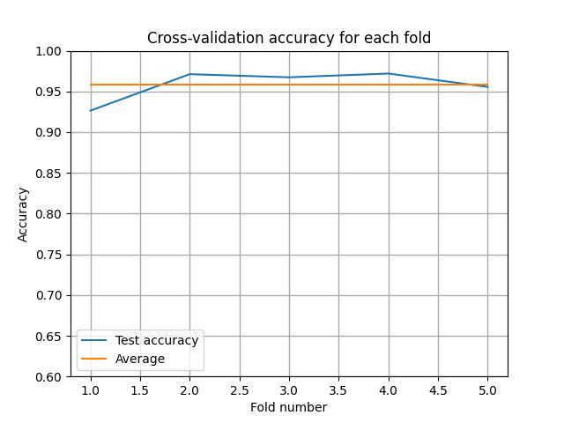
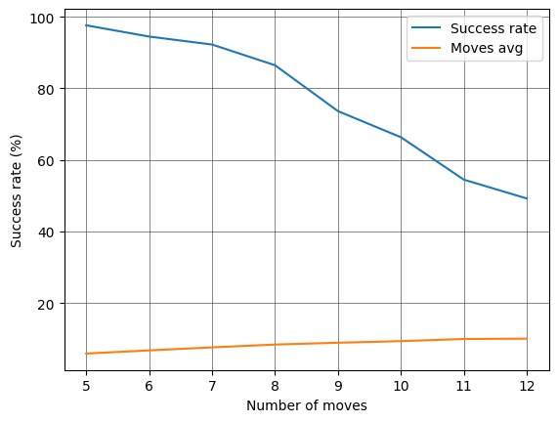
Notes:
Test done in the file src/evaluation.py and its execution can take up to 3 hours, depending on the hardware used. This graph represents the cross-validation accuracy for each fold, to evaluate the performance of our model.
We use randomly generated cubes, to see how many are solved within a timeout. In the following graph, we can observe the trend of a success rate as the number of moves applied for its construction increases, remembering that it was trained on cubes up to 8 moves and those given as input are randomly generated. An interesting fact, observable more from the textual output than from the graph because of a matter of scale, is that the average number of moves taken by the model to solve cubes generated with N random moves is always slightly greater than N by a few decimal places. If we add to this the fact that an unresolved cube, i.e., one that has gone into timeout, does not participate in this average, it can be deduced that there are cubes solvable in N moves that are solved in a greater number N moves. Getting to use more than N means that sometimes along the way he made a mistake, but still managed to "find his way back" correctly without being a Reinforcement Learning model For ex se il prof lo chiede : You have a cube solvable in 8 moves. He on average succeeds in 8.3 (example). If the average is 8.3, it means there are numbers >8 in the calculation, e.g. 9. But if he managed to solve it in 9 moves when it is optimal in 8, it means that one or more moves he got it wrong. Yet he managed to solve it successfully. Although he got a few moves wrong, he managed to "get back on track" and arrive at the solution.

Slide 27
Demo time!

